Slide 1

LIFECYCLE, HOOKS AND ROUTING
LESSON 10
CFGDEGREE → FULL-STACK STREAM

Slide 2

AGENDA
01 Lifecycle methods
02 React Hooks
03 Routing

Slide 3


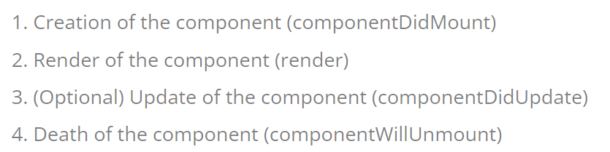
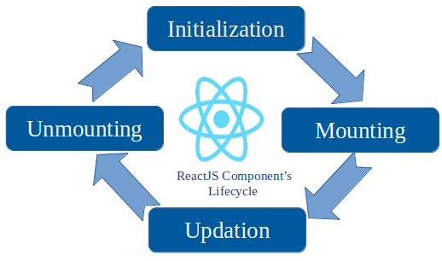
The circle of Lifecycles
Introducing lifecycle methods!
# EXAMPLE OF LIFECYCLE METHODS
These are special methods that are used to action on components during their duration / lifetime within the DOM (e.g. when they first exist / ‘mount’, update, render, disappear / ‘unmount’).
Imagine how we all go through life changes; birth, puberty, reaching adulthood, old age / eldery, death. Components have similar markers that we can target and execute code upon!
For example, we can write code to output a message when a component is ‘birthed’ / mounted or when it ‘dies’ / unmounts!

Slide 4
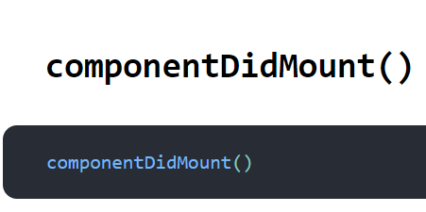
Covering a few important lifecycle methods
First up: componentDidMount!
# EXAMPLE
Called when the component is ‘birthed’ / inserted into the DOM hierarchy for the first time
This can be a useful place to call background tasks! For example, consider setting timers or making API calls (tasks that regularly can take some time, or should run in the background)

Slide 5
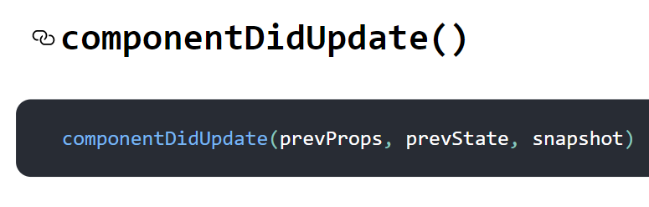
Covering a few important lifecycle methods
Second: componentDidUpdate!
# EXAMPLE
Called when the component is updated - only for changes after the initial render though (e.g. the very first render will not invoke this method!).
This can be a good place to run ‘logging’ calls or make more network calls - anything that feels appropriate for you to execute after a component is updated (e.g. maybe a logging operation to note the components state?)
Word of warning: be careful of changing the state or updating the component within this method! You could cause an infinite loop!

Slide 6
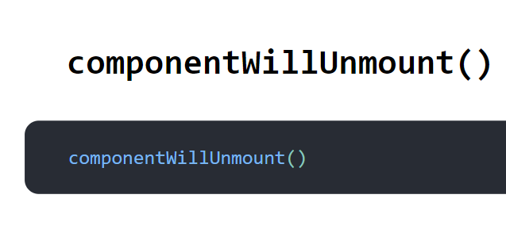
Covering a few important lifecycle methods
Finally: componentWillUnmount!
# EXAMPLE
Called right before the component is unmounted / exits / is destroyed.
This is the best place to call any clean-up operations! For example if you had started any timers, make sure to stop them in here! Or cancelling any pending network requests that you’re still waiting on.
There’s many other lifecycle methods outside of these 3 that we’ve covered in particular - however, they tend to be rarely used. Regardless methods like shouldComponentUpdate or getSnapshotBeforeUpdate or many others are still valid alternatives - make sure to check them out in your spare time!

Slide 7
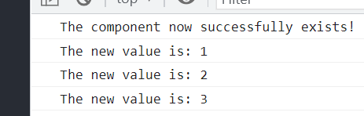
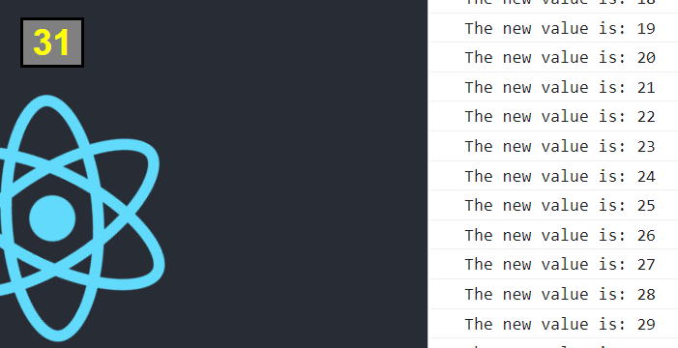
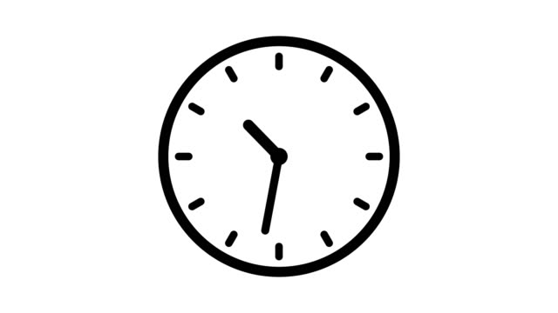
Exercise: Add a lifecycle method!
To your class-component button!
# EXAMPLE ONE
Using what you’ve learnt from the previous slides, add the appropriate lifecycle method/s to meet the requirement below:
I want there to be a console output denoting that the component successfully exists / came onto the screen
I want a console output listing the newest value everytime I click on my Increment Button counter (where the state changes and updates each time) - use a lifecycle method for this
# EXAMPLE TWO
You have approx. 10 minutes for this (depending on your instructor's discretion + current time!). Google when you can!

Slide 8


Introducing Hooks
And not the Peter Pan kind! (unfortunately)
# EXAMPLE PICTURE IS NOT RELATED
We’ve only been able to make use of state or the lifecycle methods through class components - no such luck for functional components
Introducing however hooks - this is a mechanism that allows us to access the same state & lifecycle magic via functional components instead.
To achieve this, we effectively hook onto State or lifecycle methods to make use of it ourselves without needing class components
We can create our own custom hooks, but for the time being, we’ll be using React’s in-built hooks (useState for State, useEffect for lifecycle effects, etc)

Slide 9
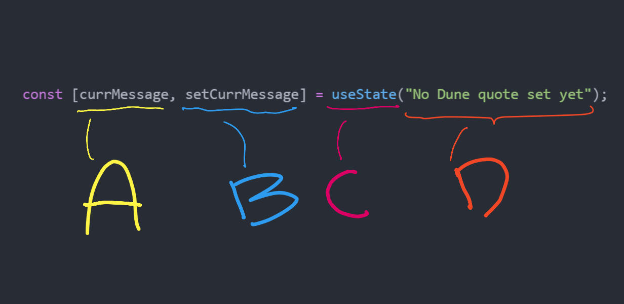
State via useState
Introducing one of the most important hooks we can use
First, you’ll need to import this hook via the useState import command at the very top of your component file e.g:
import React, { useState } from 'react';
Within the [] on the right hand side, the first parameter symbolises the state object itself whilst the second parameter is the setState method we used in our class components - this time though, we can name it to anything we want though (though make sure to still name appropriately! E.g. make sure your state change always starts with a set for convention!).
Your instructor can cover all points on the right
# CONCEPTUAL BREAKDOWN

Slide 10
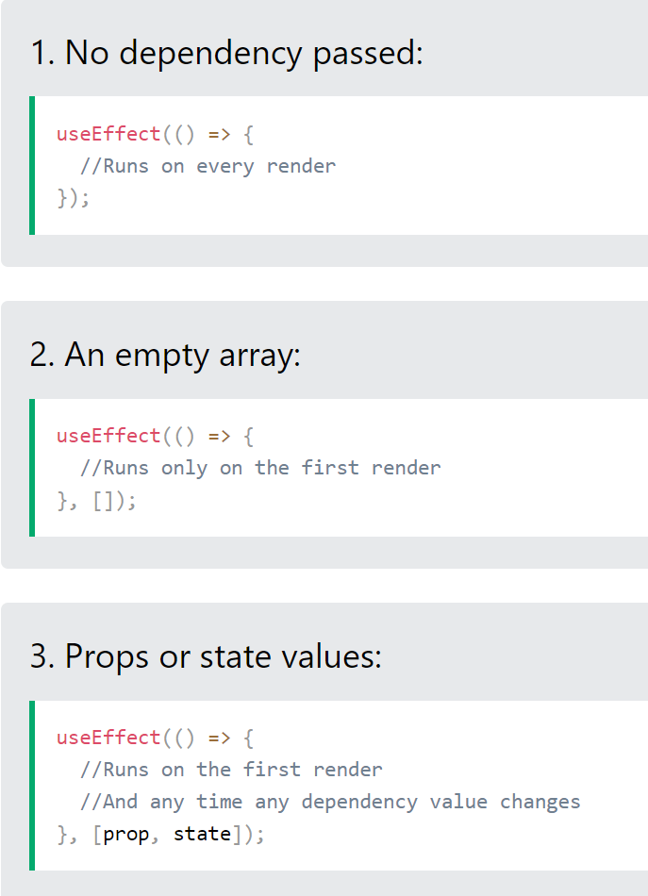
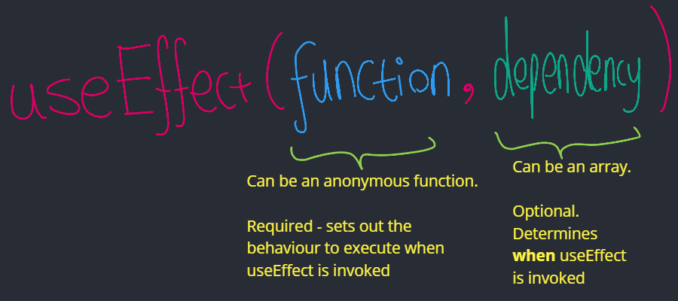
Lifecycle effects via useEffect
Admittedly, better via a hook than lifecycle methods
Imagine if componentDidMount and componentDidUpdate were combined together? The result would be useEffect
This is a hook that runs based on whether its assigned dependency has changed since last time - it’ll run once after first render, then keep an eye out for further changes!
This level of customizability makes this hook incredibly powerful! Your instructor can go into depth on each part / diagrams here

Slide 11
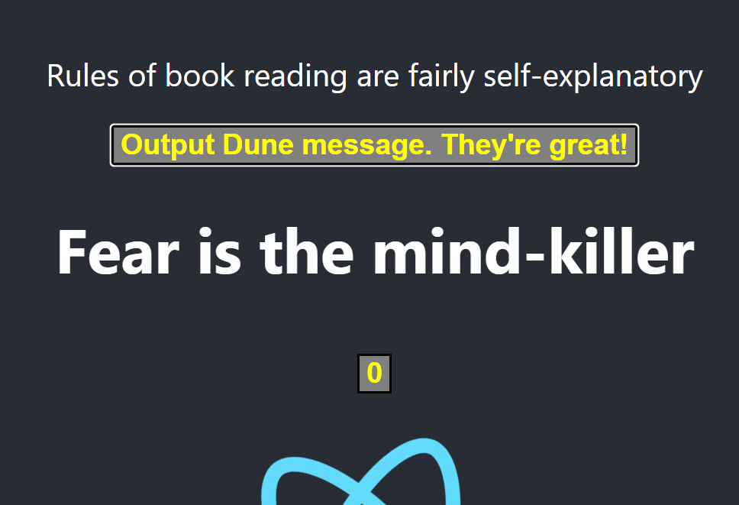
Exercise 2: Add a hook onto a component!
To an existing functional component (your first button?) or create a new one for use
# EXAMPLE
Going back to your first functional-component button (alternatively if you don’t have one, create one quickly!), add hooks into it!
Using hooks, meet the following criteria:
When the component first loads, there’s a console output of “Hello World” - this should only happen once.
Everytime the button is clicked, its text should change into something different (any text is fine). Alternatively, the text of another element (part of the component, e.g. a h1) should change.
(^ Difficult - consider using a certain hook twice, alongside useState! Since the certain hook triggers on re-renders)
You have approx. 15 minutes for this (depending on your instructor's discretion + current time!). Google when you can!

Slide 12

So which is better? Class vs Function
What should your components look like in the future?
This is a source of a large amount of discourse within React - both are objectively the correct choice
The recommendation for the time being is using functional component - this will be something that’ll be used for the rest of the sessions.
Moreover, it seems that the React community is slowly moving towards functional components (particularly due to hooks).
Regardless, using class components in your project or your code in general is still correct & accepted!
# A DIFFICULT CHOICE
Notes:
Give your own thoughts as instructor as well! It’s likely that these slides could be wrong / not as accurate + your opinion would be v. useful in providing both sides of an argument to the students - this slide is just to address the immediate question for students who are thinking of “wait, which type should we use then?”

Slide 13
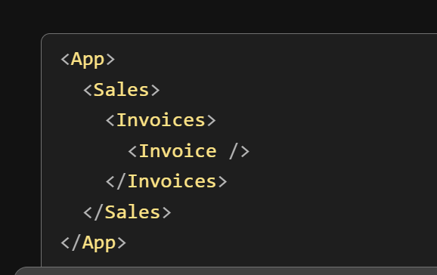
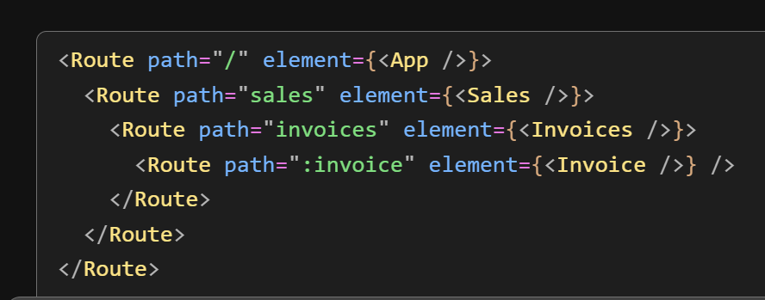
React Routing
Finally handling navigation!
React Router is a routing library that we can add to our project - it allows us to build navigation between pages without us needing to refresh the browser as the user navigates!
The prevention of a page refresh means that there isn’t any white or blank screen displayed, giving the user a more seamless experience.

Slide 14
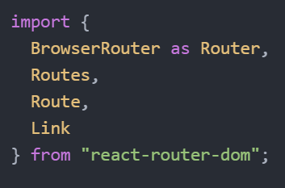
Walkthrough: Adding simple routing (Pt. 1)
We’ll do this solution together; make sure to ask questions & understand!
First we’ll want to run the command npm install react-router-dom (or the yarn equivalent); this is to install the library first!
Second: in your index.js, import these. Consider throughout - what does each one do, what is it responsible for, why? Although this code is guided, make sure to try to understand / treat this as a pair programming session!
Continue to next slide!

Slide 15
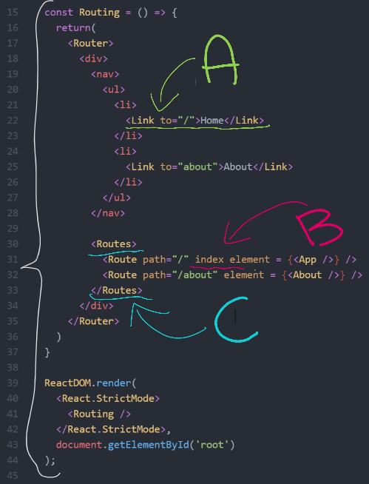
Walkthrough: Adding simple routing (Pt. 2)
Part 2 of adding routing!
Create a new component called About.js - make it similar to the App.js component page with some differences so you can tell that they’re separate (e.g. change the text). For this, feel free to just copy code whenever relevant (e.g. the css code used in App.css).
Once this is done, write this code into your index.js - your index.js (apart from its imports) should look like the code on the right. What do you think it does, what do you think it’ll change? Take particular note of A, B and C - your instructor can give further explanations on them.
Continue onto the next slide!

Slide 16
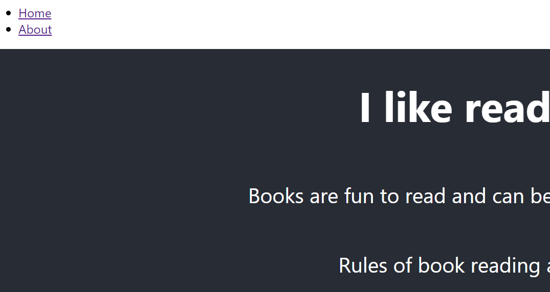
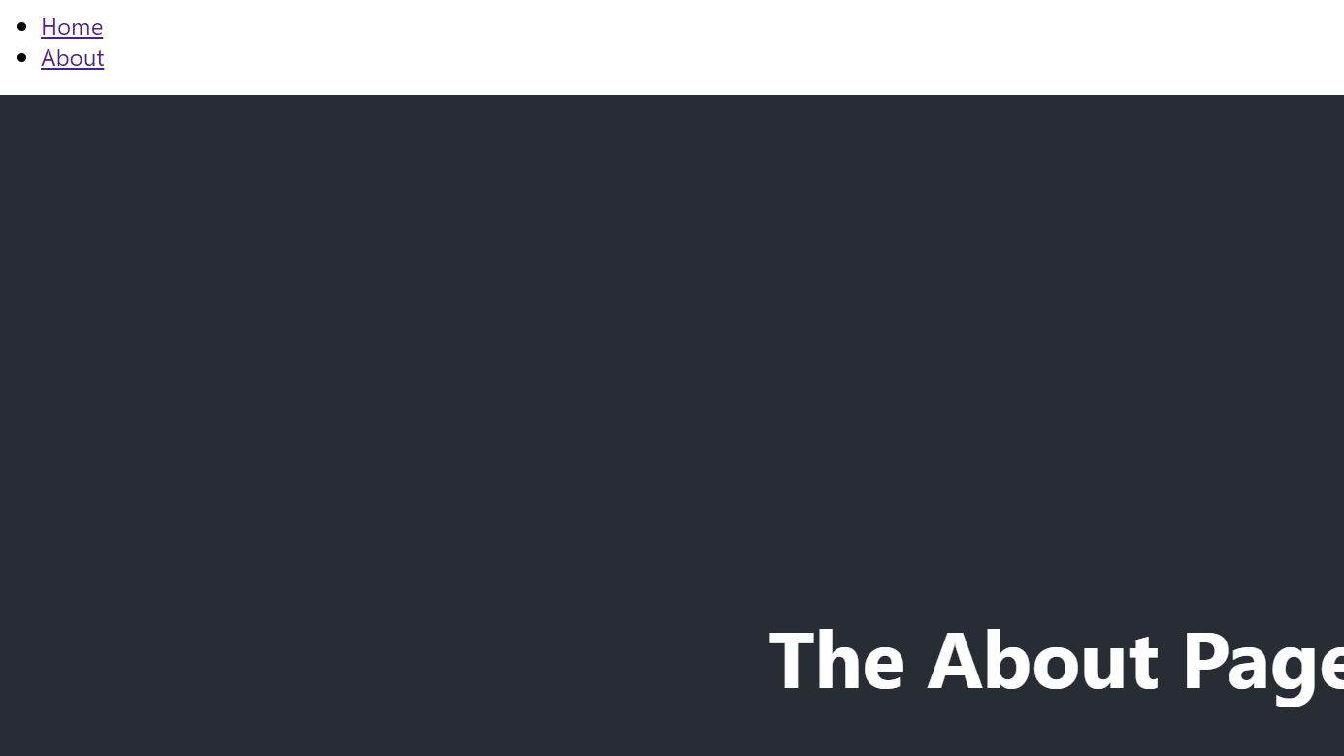
Walkthrough: Adding simple routing (Pt. 3)
Part 2 of adding routing!
By this point, you should have two ‘pages’ that are now accessible through React routing! Importantly, these pages should be visible to you without them reloading or going through a white ‘loading’ screen - they’re available to view immediately.
An experience like this allows us to create web apps that provide a more robust, seamless experience for a user visiting our site - the website looks like it ‘flows’ from page to page instead of statically rendering over and over again. The best part is that any updates affect components locally (e.g. state changes), so the whole DOM doesn’t have to be reloaded!
This was a quick introduction to routing (due to time constraints), but make sure to take it further! Use online documentation and react routing’s library guidances to build your projects to go even further.

Slide 17
SUMMARY
Lifecycle methods can be used to manipulate components during their lifecycle - for example when they first mount, whenever they’re updated (e.g. via state changes) or when they dismount
Hooks are a mechanism that allows us to access State and Lifecycle methods in functional components, hence not restricting our development to be exclusively being class components forever (since we have the same benefits!)
Routing is a powerful library for use within React, as it lets us add multiple pages without any loading between them!

Slide 18
THANK YOU!

